Slide 1
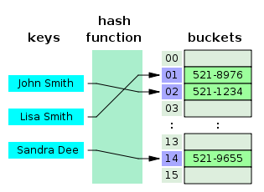
COSC 222 Data Structures
Yves Lucet
CC BY-SA 3.0 https://en.wikipedia.org/wiki/Skip_list#/media/File:Skip_list_add_element-en.gif
"Hash table 3 1 1 0 1 0 0 SP" by Jorge Stolfi - Own work. Licensed under CC BY-SA 3.0 via Commons - https://commons.wikimedia.org/wiki/File:Hash_table_3_1_1_0_1_0_0_SP.svg#/media/File:Hash_table_3_1_1_0_1_0_0_SP.svg
Notes:
11am

Slide 2
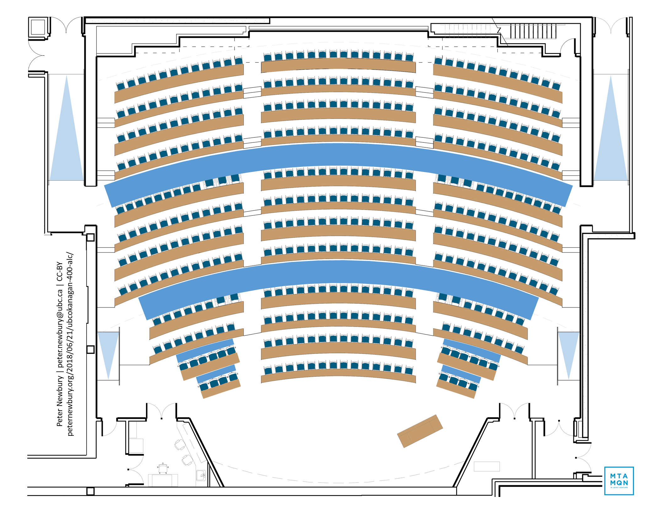
25
26
27
10
11
37
38
9
22
23
24
8
35
36
7
19
20
21
6
33
34
16
17
18
5
31
4
32
14
15
2
3
30
29
12
13
28
1

Slide 3

Announcements

Slide 4


Slide 5
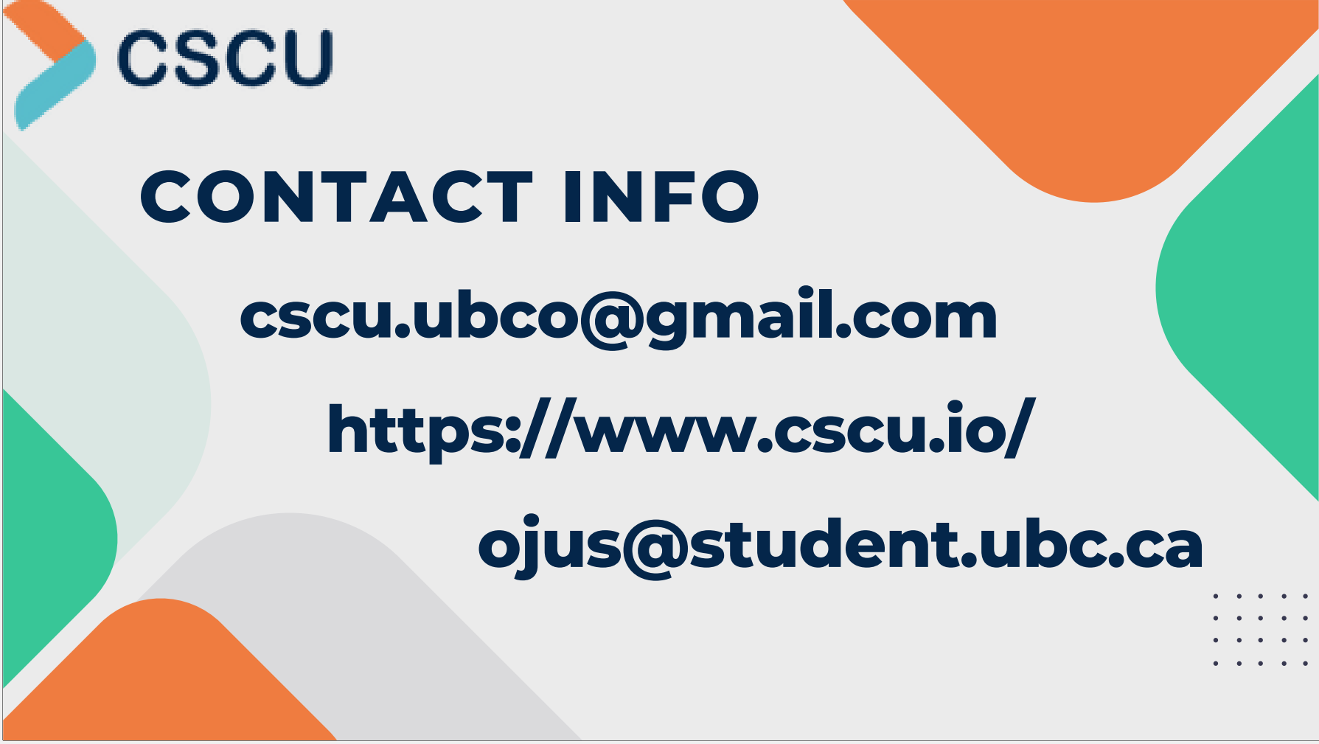

Slide 6


Slide 7
Teams
Teams created and posted to Ms Teams
Data uploaded to InteDashboard and email sent
You should be able to log in to InteDashboard!
Technical issues, e.g., you haven’t provided an email address, should be posted on Teams Technical issue channel for everyone to benefit
Private technical issues should be sent through Teams private chat or by email (Canvas or direct).

Slide 8
Please be responsive and aware of deadlines!
With 200+ students and 38 teams, I want to focus my time on your learning and minimize one-on-one technical support

Slide 10

Menu
Generics
Git
Unit testing
Coverage testing
Java complement
Debugger
Dashboard practise
Readings
Image courtesy of Gregory Szarkiewicz / FreeDigitalPhotos.net

Slide 11
Generics

Slide 12
public class Node {
// Instance variables:
private Object element;
private Node next;
public Node() {
this(null, null);
}
public Node(Object e, Node n) {
element = e;
next = n;
}
public Object getElement() { return element;}
public Node getNext() {return next;}
public void setElement(Object newElem) {
element = newElem;
}
public void setNext(Node newNext) {
next = newNext;
}
}
public class Node <E> {
// Instance variables:
private E element;
private Node<E> next;
public Node() {
this(null, null);
}
public Node(E e, Node<E> n) {
element = e;
next = n;
}
public Object getElement() {return element; }
public Node<E> getNext() {return next;}
public void setElement(E newElem) {
element = newElem;
}
public void setNext(Node<E> newNext) {
next = newNext;
}
}
/** Creates a node with null references to its element and next node. */
/** Creates a node with the given element and next node. */
// Accessor methods:
// Modifier methods:

Slide 13
Generics example
public class Pair <K, V> {
K key;
V value;
public void set(K k, V v){
key = k;
value = v;
}
….

Slide 14
Generics example
….
public K getKey() { return key;}
…
public static void main (String[] args){
Pair<String, Integer> pair1 = new Pair<String, Integer>();
pair1.set(new String(“height”), new Integer(36));
Pair<Student,Double> pair2 = new Pair<Student,Double>();
pair2.set(new Student(“A5976”,”Sue”,19), new Double(9.5));
…
}

Slide 15
Generics and Arrays
allow declaration of arrays storing a parametrized type
Pair<String,Double>[ ] holdings;
forbid instantiation of such arrays
holdings = new Pair<String,Double>[25];//compile error
holdings = new Pair[25];
holdings[0] = new Pair<>(“ORCL”, 32.07);
public class Portfolio<T> {
T[ ] data;
public Portfolio(int capacity){
data = new T[capacity];//compiler error
data = (T[ ]) new Object[capacity];
} …
}
Notes:
Do not know the type at runtime

Slide 16

Diving deeper
Contrary to C++ templates, there is only ONE copy of the generic class: one single .class file
There is a single copy of the code in source, binary, memory, and disk.
When a generic declaration is invoked, the actual type arguments are substituted for the formal type parameters
This is called type erasure: compiler erases all type related information during compile time and no type related information is available during runtime.

Slide 17
Type erasure
For example, List<Integer> will be converted to the non-generic type List, which ordinarily contains arbitrary objects. The compile-time check guarantees that the resulting code is type-correct.
the Java run-time environment does not need to know which parameterized type is used because the type information is validated at compile-time and is not included in the compiled code.

Slide 18

Diving deeper
To restrict the parameter, use the extends clause:
public class Student {
Student(String s, String n, int age){}
}
public class Person<P extends Student> {
public Person(){}
public void insert(P person, P other){}
public P findOther(P person){return null;}
public void remove(P person, P other){}
}
There is also a super keyword

Slide 19
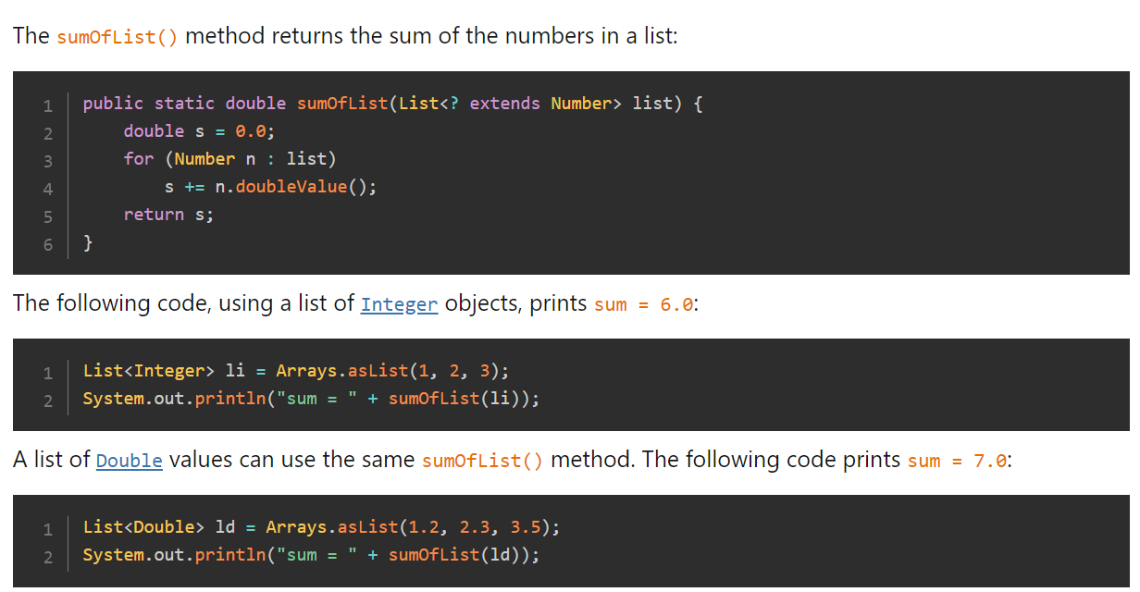
Upper bounded wildcard
https://dev.java/learn/wildcards/

Slide 20
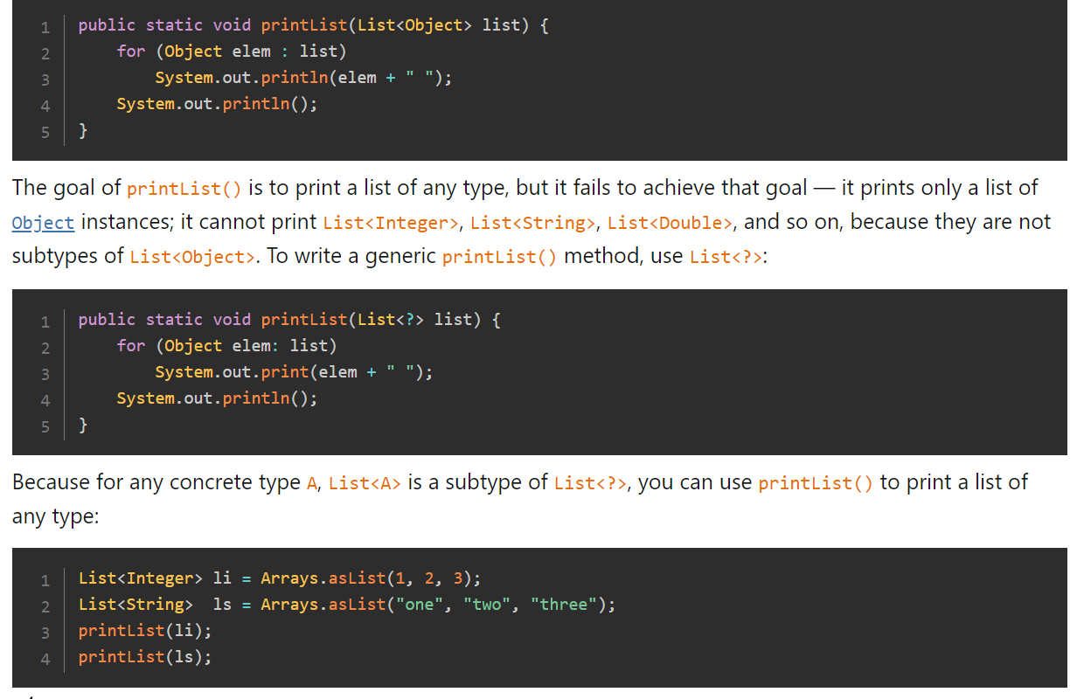
Unbounded wildcard
https://dev.java/learn/wildcards/

Slide 21
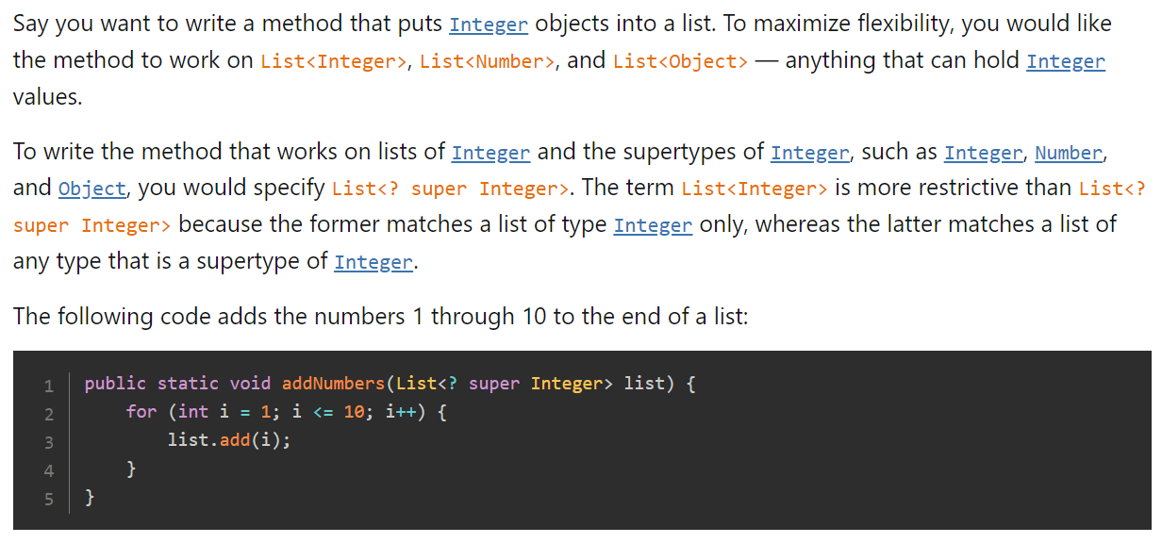
Lower bounded wildcard
https://dev.java/learn/wildcards/

Slide 22
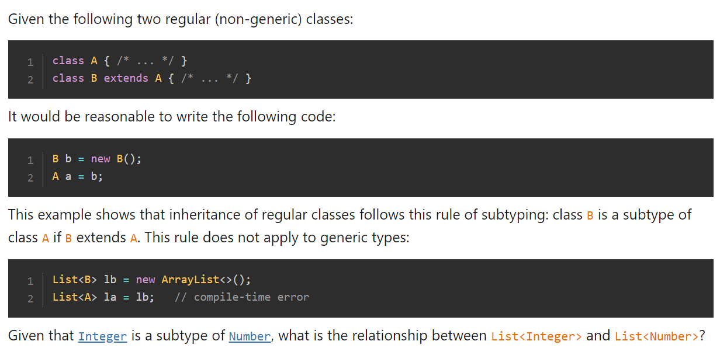
https://dev.java/learn/wildcards/

Slide 23
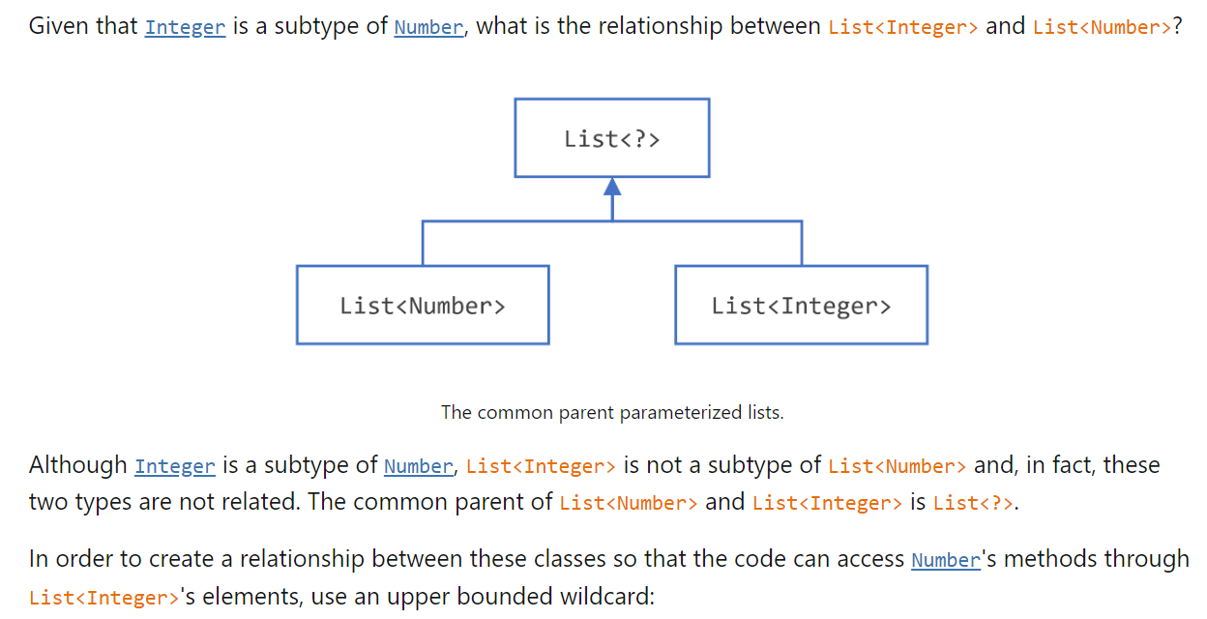
https://dev.java/learn/wildcards/

Slide 24
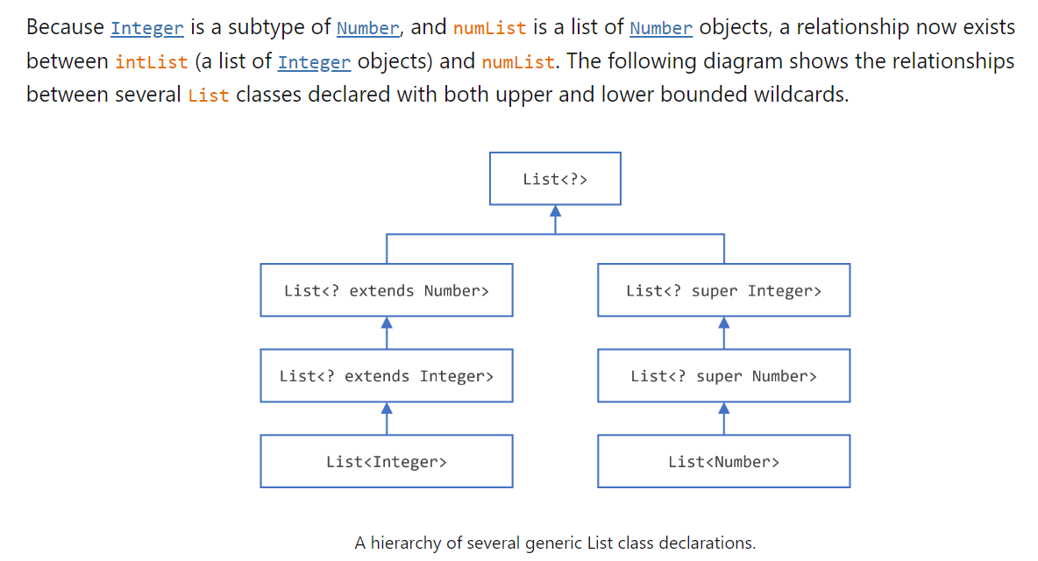
https://dev.java/learn/wildcards/

Slide 25
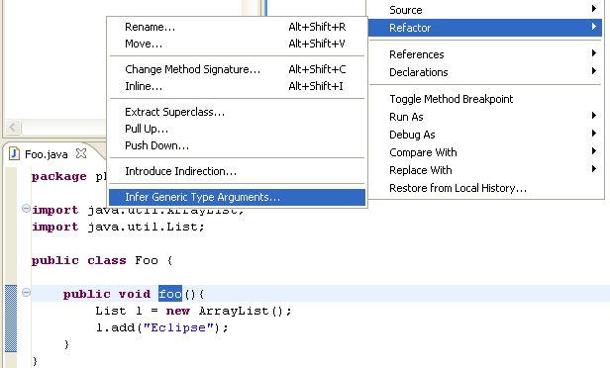

Eclipse Support for Generics

Slide 26
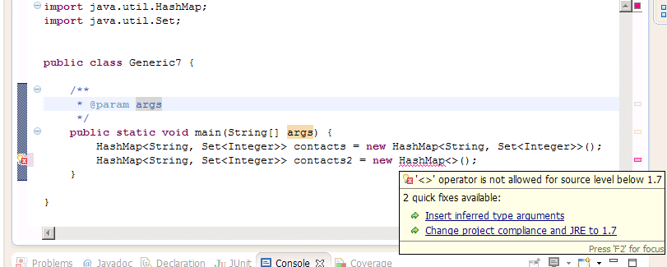
Java 7

Slide 27
Interview questions on Generics
What is Generics in Java ? What are advantages of using Generics?
How Generics works in Java ? What is type erasure ?
What is Bounded and Unbounded wildcards in Generics ?
What is difference between List<? extends T> and List <? super T> ?
How to write a generic method which accepts generic argument and return Generic Type?
How to write parametrized class in Java using Generics ?
Write a program to implement LRU cache using Generics ?
Can you pass List<String> to a method which accepts List<Object>?
Can we use Generics with Array?
How can you suppress unchecked warning in Java?
Difference between List<Object> and raw type List in Java?
Difference between List<?> and List<Object> in Java?
Difference between List<String> and raw type List
http://javarevisited.blogspot.sg/2012/06/10-interview-questions-on-java-generics.html
Notes:
LRU=Least Recently Used

Slide 28
More interview questions on generics
What Is a Generic Type Parameter?
What Are Some Advantages of Using Generic Types?
What Is Type Erasure?
If a Generic Type Is Omitted When Instantiating an Object, Will the Code Still Compile?
How Does a Generic Method Differ from a Generic Type?
What Is Type Inference?
What Is a Bounded Type Parameter?
Is It Possible to Declared a Multiple Bounded Type Parameter?
What Is a Wildcard Type?
What Is an Upper Bounded Wildcard?
What Is an Unbounded Wildcard?
What Is a Lower Bounded Wildcard?
When Would You Choose to Use a Lower Bounded Type vs. an Upper Bounded Type?
Are There Any Situations Where Generic Type Information Is Available at Runtime?
https://www.baeldung.com/java-generics-interview-questions

Slide 29
Reference
Eclipse Help “infer generic argument”
https://dev.java/learn/generics/
https://aioo.be/mirrored/java-theory-and-practice-generics-gotchas.html

Slide 30


Questions?
This Photo by Unknown Author is licensed under CC BY
Notes:
11:15am

Slide 31
Git
init
add
commit
push
pull
clone
status
log
fetch
branch
pull request
merge

Slide 32
inteDashboard
Practice RAT: iRAT + tRAT

Slide 33
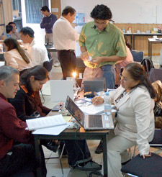
Reading list on Canvas
1 readings-Java-UnitTesting.txt
Review on Java language
New topics:
Generics
Testing: unit testing handout.pdf file
There will be questions on your understanding before moving on

Slide 35
RAT test next class!
Do your readings!

Slide 36

[T]here are known knowns; there are things we know that we know. There are known unknowns; that is to say there are things that, we now know we don't know. But there are also unknown unknowns – there are things we do not know, we don't know.
United States Secretary of Defense, Donald Rumsfeld, 2002
picture from http://www.soothetube.com/2013/12/29/thats-all-folks/

